Slide 1
Tracking with Recency Assays to Control the Epidemic (TRACE) Public Health Surveillance and Response : Using Data for Action

Slide 2
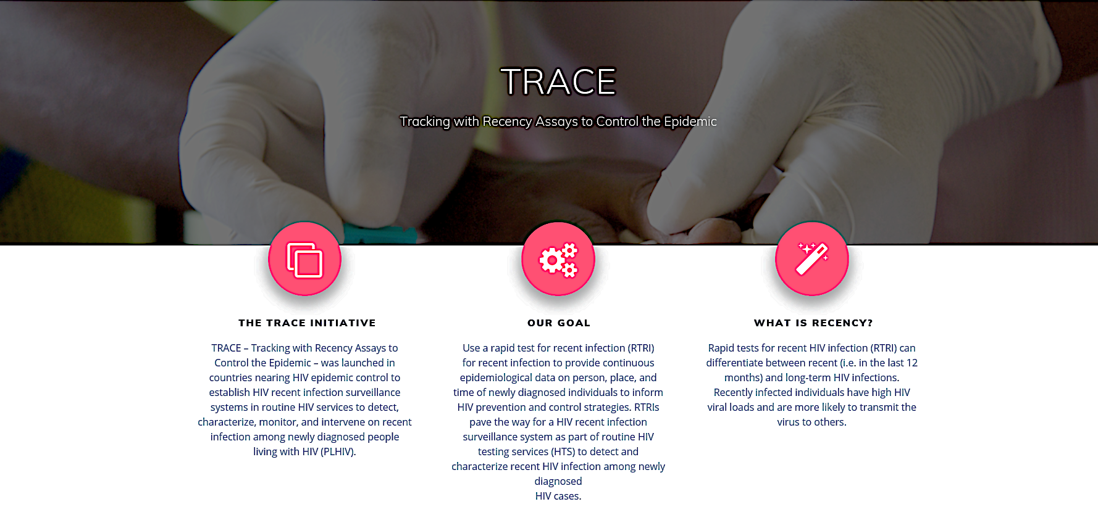
PEPFAR’s Public Health Surveillance & Response Initiative

Slide 3
Effective epidemic control requires quick detection and response

Slide 4
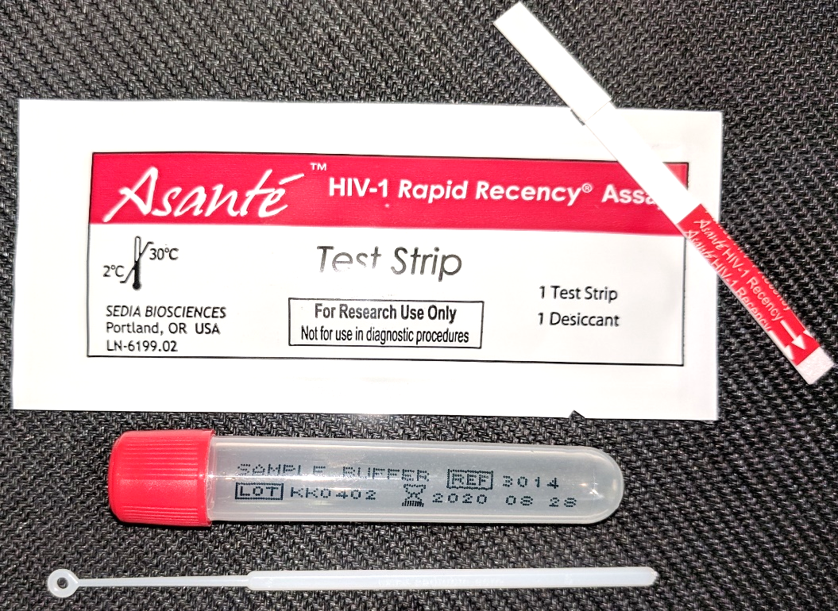
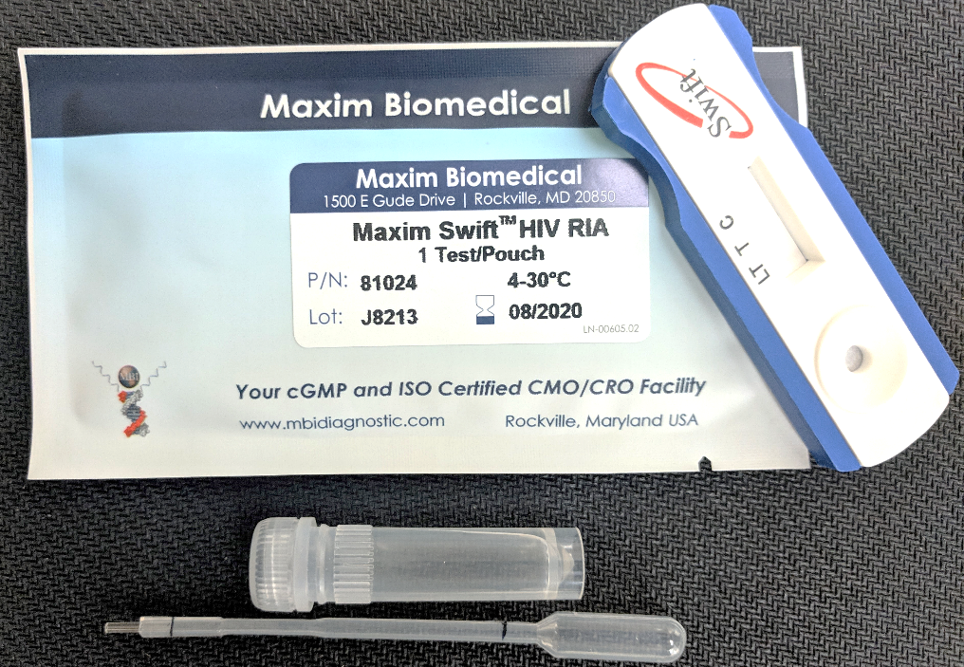
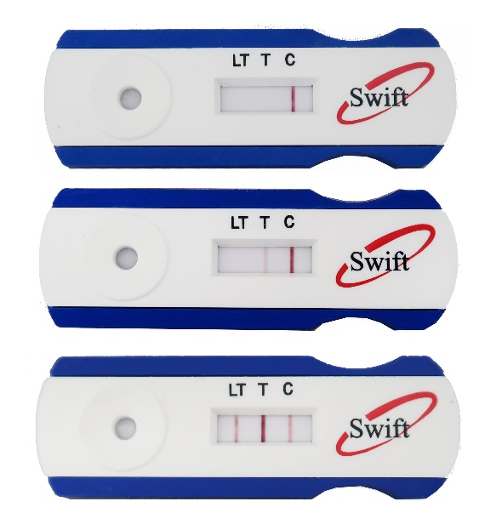
HIV rapid tests for recent infection
Sedia Asante – Dip Stick
Maxim Swift – Cassette
LT
V
C
Negative
Negative
Recent
Recent
Long-term
Long-term

Slide 5
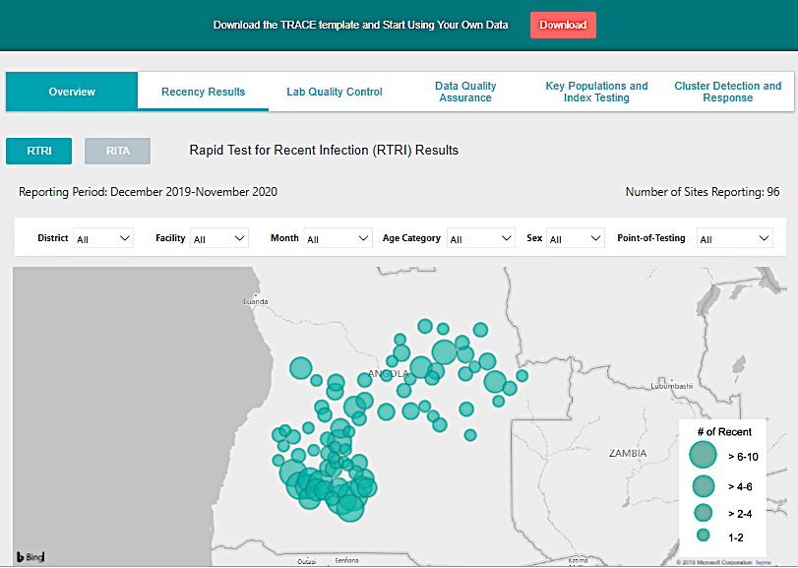
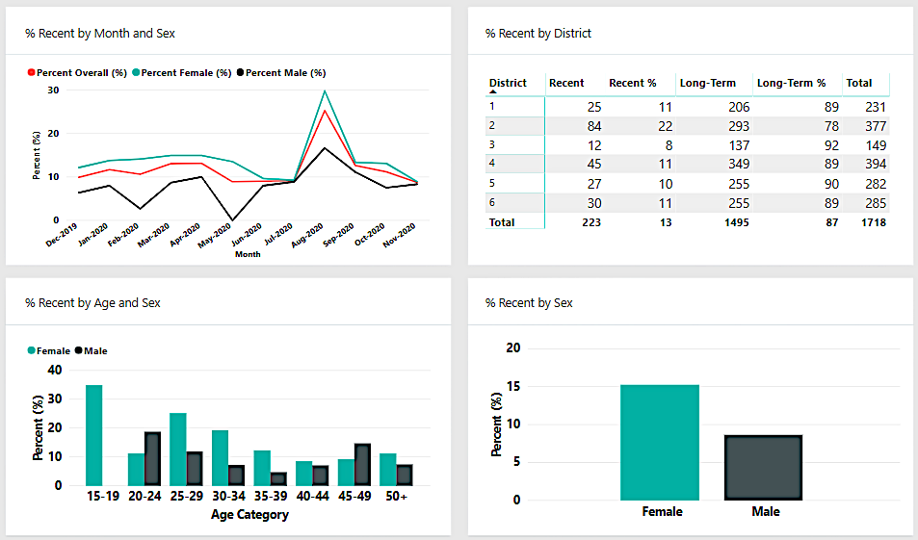
Real-time data review through TRACE data dashboards
*Simulated data used

Slide 6
Interpreting HIV recent infection trends…it’s not simple
but trends over time by geography will be critical
Know your population
TRACE provides trends in the ‘proportion’ recent among the newly HIV diagnosed population
Context and data triangulation are critical for interpretation of trends
proportion of PLHIV diagnosed and on ART
program’s HIV testing efforts
persons’ HIV testing patterns
Recent infections indicate ongoing HIV transmission AND early HIV diagnosis.
An increase in the number or proportion testing recent may mean:
new HIV infections are increasing
program increasing testing efforts and diagnosing PLHIV early
persons at risk are retesting frequently

Slide 7
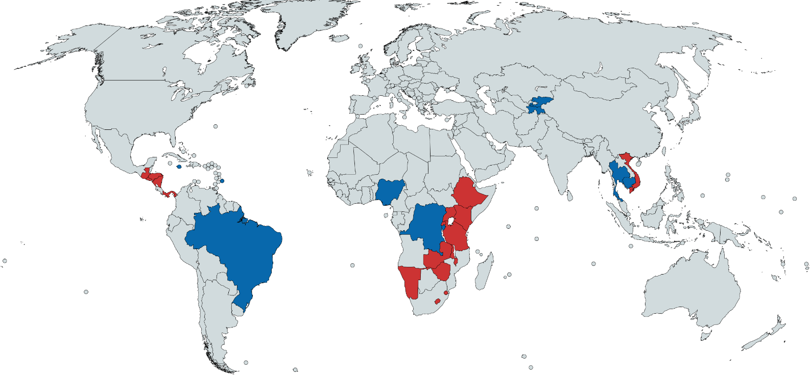
PEPFAR-supported countries implementing TRACE, FY19 & FY20
By year-end FY19, 17 PEPFAR-supported countries will have established recent infection surveillance systems, and by year-end FY20, an additional 10 countries will be added.
Kyrgyz Republic
Tajikistan
Barbados
Brazil
Jamaica
El Salvador
Guatemala
Honduras
Nicaragua
Panama
Vietnam
eSwatini Ethiopia
Kenya
Lesotho
Malawi
Namibia
Rwanda
Tanzania
Uganda
Zambia
Zimbabwe
Cambodia
Thailand
Burundi DRC
Nigeria
TRACE FY19
TRACE FY20

Slide 8
Standing up TRACE: Integrating recency testing into routine HIV testing programs
National HIV testing algorithm
National M&E systems
National surveillance systems
Public health Response
HTS client
Rapid Test 1
Report NEGATIVE
Non Reactive
Reactive
Rapid Test 2
INDETERMINATE
(Follow country guidelines)
Non Reactive
Reactive
Report POSITIVE
Rapid test for recent infection (RTRI)
Supplementary test for recent infection among newly diagnosed
Tested
recent
Tested
Long term
Viral load test
Confirmed recent
(Tested recent + VL≥1,000 copies/mL)
Report RECENT

Slide 9
Vision: Integrating recency testing in national policies for HIV testing, disease surveillance and emergency response
HIV testing services site
(facility or community)
National M&E Systems
Notifiable Disease
Reporting
Public Health Surveillance and Response
HTS client
Rapid Test 1
HIV-NEGATIVE
Non Reactive
Reactive
Rapid Test 2
Rapid Test for Recent Infection
HIV-INDETERMINATE
Non Reactive
Reactive
HIV-POSITIVE
HIV-LONGTERM
Long-term line present
Long-term line absent
PROBABLE HIV-RECENT
Viral load laboratory
Viral load test
HIV-LONGTERM
RNA <1,000 copies/mL
RNA ≥ 1,000 copies/mL
CONFIRMED HIV-RECENT

Slide 10
Vision: Translating innovation to policy
Central America Region
Recency testing to be included in national HIV case reporting policy in Guatemala and Nicaragua
Recency tests included in the Council of Ministries of Health from Central America (COMISCA) regional purchase list to standardize test price
Rwanda: National HIV Testing Technical Working Group has proposed inclusion of routine recency testing in the National Prevention Guideline revision, August 2019
Ethiopia: HIV case surveillance with recency testing included in the National Public Health Emergency Management guidelines
Kenya: Ministry of Health endorsed HIV case surveillance guidelines for implementation with recency testing among newly diagnosed

Slide 11
Vision: Guided by a surveillance to program continuum
HIV case surveillance system
Public Health Response
Client-centered programs
Improved quality of care
Analyze, investigate, intervene
Recency testing of newly diagnosed

Slide 12
Acknowledgement
PEPFAR Recency Community of Practice: OGAC, CDC, DOD, USAID, PEPFAR country teams, PEPFAR Implementing Partners
TRACE extramural partners: UCSF & ICAP
Ministries of Health from El Salvador, Guatemala, Honduras, Nicaragua, Panama, Ethiopia, Kenya, and Rwanda

